Slide 1
Solace shoes
It started with a simple idea: Create quality, well-designed products that I wanted myself.

Slide 2
Index
What is solace shoes
Services
Who are we
Additional features

Slide 3
What is solace shoes
Our shop is a group of exceptionally skilled, experienced, and grant winning creators.
Our shoes are innovative Full Grain Leather development, lightweight and amazingly sturdy.
Hard core Anti-slide elastic sole that gives fantastic hold on street.

Slide 4
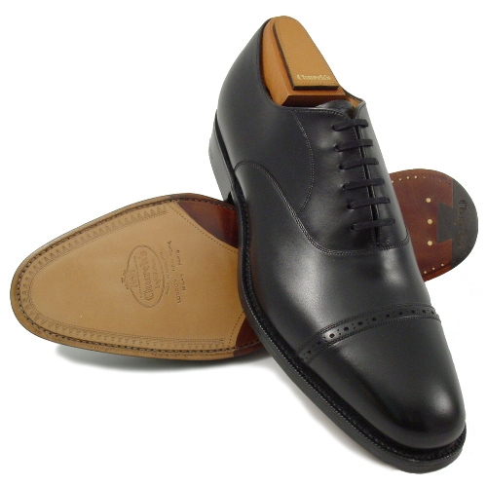
Services
All made to last and supported by our amazing client assistance.

Slide 5
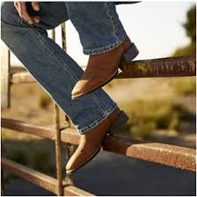
Services
Find the solace and exemplary styles of our Men's dress, Women's apparel and Kids' dressing alongside L.L.Bean Boots, shoes and shoes.

Slide 6
Who are we
L.L.Bean - The Outside Is Inside Everything We make. Founded in 1912 by Leon Leonwood Bean, L.L.Bean offers thousands of high-quality products at reasonable prices.

Slide 7
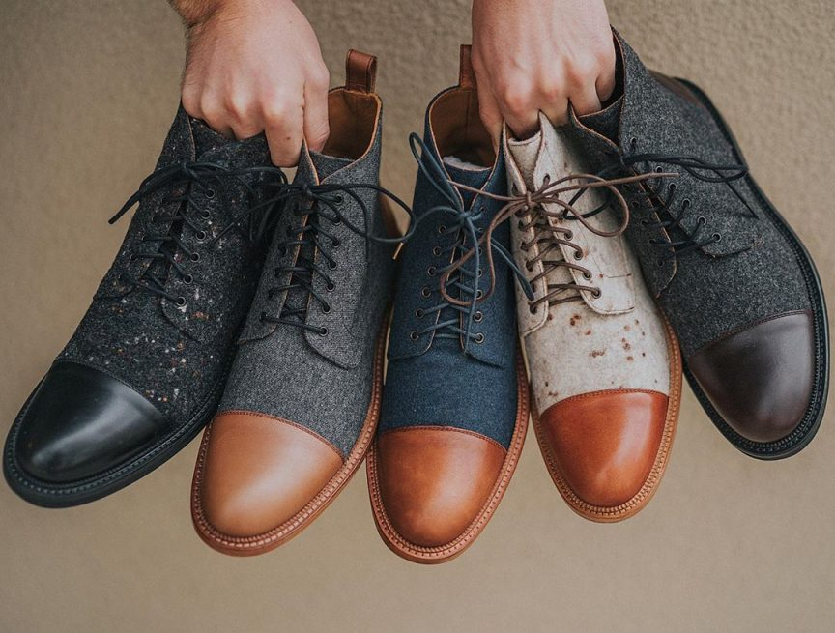
Additional features
Contoured TPU heel protection reinforced with shock absorbing TPR.
Stun engrossing latex froth on flex boards, Padded front and back lower leg region.
Our shoes are double stitched at all high-stress areas.

Slide 8
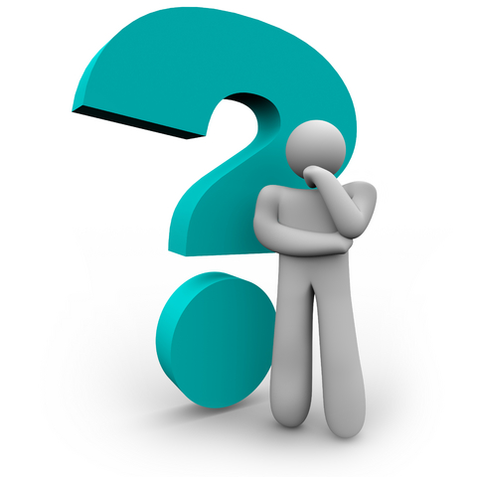
QUESTIONS?
This Photo by Unknown Author is licensed under CC BY

